Slide 1




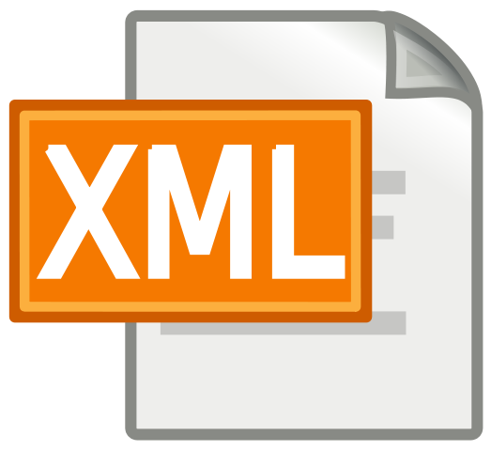

XML Processing
Parsing XML
XDocument and LINQ
XML
SoftUni Team
Technical Trainers
Software University
http://softuni.bg

Slide 2


Table of Contents
XML Format
Processing XML
XML in Entity Framework
XML Attributes

Slide 3
Questions
sli.do #CSharpDB

Slide 4
What is XML?
Format Description and Application

Slide 5
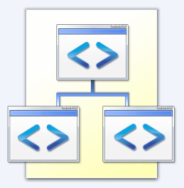
What is XML?
EXtensible Markup Language
Universal notation (data format / language) for describing structured data using text with tags
Designed to store and transport data
The data is stored together with the meta-data about it

Slide 6
XML – Example
XML header tag (prolog)
Attribute (key / value pair)
<?xml version="1.0"?>
<library name="Developer's Library">
<book>
<title>Professional C# 4.0 and .NET 4</title>
<author>Christian Nagel</author>
<isbn>978-0-470-50225-9</isbn>
</book>
<book>
<title>Teach Yourself XML in 10 Minutes</title>
<author>Andrew H. Watt</author>
<isbn>978-0-672-32471-0</isbn>
</book>
</library>
Root (document) element
Element
Opening tag
Closing tag
Element value

Slide 7
XML Syntax
Header – defines version and character encoding
Elements – define the structure
Attributes – element metadata
Values – actual data, can also be nested elements
Root element – required to only have one
<?xml version="1.0" encoding="UTF-8"?>
Element name
Attribute
Value
<title lang="en">Professional C# 4.0 and .NET 4</title>

Slide 8
XML - Structure
Header
Document
Document root
Attribute
Xml
version: 1.0
Library
name: Developer's Library
Book
Book
Book
Book
Child elements
Title
Author
ISBN
Professional C# 4.0 and .NET 4
Christian Nagel
978-0-470-50225-9
Value

Slide 9


XML and HTML
Similarities between XML and HTML
Both are text based notations
Both use tags and attributes
Differences between XML and HTML
HTML describes documents, XML is a syntax for describing other languages (meta-language)
HTML describes the layout of information, XML describes the structure of information
XML requires the documents to be well-formatted

Slide 10

XML: Advantages
Advantages of XML:
XML is human-readable (unlike binary formats)
Store any kind of structured data
Data comes with self-describing meta-data
Full Unicode support
Custom XML-based languages can be designed for certain apps
Parsers available for virtually all languages and platforms

Slide 11
XML: Disadvantages
Disadvantages of XML:
XML data is bigger (takes more space) than binary or JSON
More memory consumption, more network traffic, more hard-disk space, more resources, etc.
Decreased performance
CPU consumption: need of parsing / constructing the XML tags
XML is not suitable for all kinds of data
E.g. binary data: graphics, images, videos, etc.

Slide 12

Parsing XML
Using XDocument and LINQ

Slide 13
LINQ to XML
LINQ to XML
Use the power of LINQ to process XML data
Easily read, search, write, modify XML documents
LINQ to XML classes:
XDocument – represents a LINQ-enabled XML document (containing prolog, root element, …)
XElement – main component holding information

Slide 14
Reading XML
To process an XML string:
Loading XML directly from file:
string str =
@"<?xml version=""1.0""?>
<!-- comment at the root level -->
<Root>
<Child>Content</Child>
</Root>";
XDocument doc = XDocument.Parse(str);
XDocument xmlDoc = XDocument.Load("../../books.xml");

Slide 15
Working with XDocument
Access root element
Get collection of children
Access element by name
var cars = xmlDoc.Root.Elements();
foreach (var car in cars)
{
string make = car.Element("make").Value;
string model = car.Element("model").Value;
Console.WriteLine($"{make} {model}");
}
Get value

Slide 16
Working with XDocument (2)
Set element value by name
If it doesn't exist, it will be added
If set to null, will be removed
Remove element from it's parent
customer.SetElementValue("birth-date", "1990-10-04T00:00:00");
var youngDriver = customer.Element("is-young-driver");
youngDriver.Remove();

Slide 17
Working with XDocument (3)
Get or set element attribute by name
Get a list of all attributes for an element
Set attribute value by name
If it doesn't exist, it will be added
If set to null, will be removed
customer.Attribute("name").Value
var attrs = customer.Attributes;
customer.SetAttributeValue("age", "21");

Slide 18
LINQ to XML – Searching with LINQ
Searching in XML with LINQ is like searching with LINQ in array
XDocument xmlDoc = XDocument.Load("cars.xml");
var cars = xmlDoc.Root.Elements()
.Where(e => e.Element("make").Value == "Opel" &&
(long)e.Element("travelled-distance") >= 300000)
.Select(c => new
{
Model = c.Element("model").Value,
Traveled = c.Element("travelled-distance").Value
})
.ToList();
foreach (var car in cars)
Console.WriteLine(car.Model + " " + car.Traveled);

Slide 19
Creating XML with XElement
XDocuments can be composed from XElements and XAttributes
<books>
<book>
<author>Don Box</author>
<title lang="en">Essential .NET</title>
</book>
</book>
Added with value
XDocument xmlDoc = new XDocument();
xmlDoc.Add(
new XElement("books",
new XElement("book",
new XElement("author", "Don Box"),
new XElement("title", "ASP.NET", new XAttribute("lang", "en"))
)));
Add as root
Optional attribute

Slide 20
Serializing XML to File
To flush XDocument to file with default settings:
To disable automatic indentation:
To serialize any object to file:
xmlDoc.Save("myBooks.xml");
xmlDoc.Save("myBooks.xml", SaveOptions.DisableFormatting);
var serializer = new XmlSerializer(typeof(ProductDTO));
using (var writer = new StreamWriter("myProduct.xml"))
{
serializer.Serialize(writer, product);
}

Slide 21
Deserialize XML from String XML
To deserialize object from XML string
Specifying root attribute name
var serializer = new XmlSerializer(typeof(OrderDto[]), new XmlRootAttribute("Orders"));
var deserializedOrders =
(OrderDto[])serializer.Deserialize(new StringReader(xmlString));
var attr = new XmlRootAttribute("Orders");
var serializer = new XmlSerializer(typeof(OrderDto[]), attr);
var deserializedOrders =
(OrderDto[])serializer.Deserialize(new StringReader(xmlString));

Slide 22
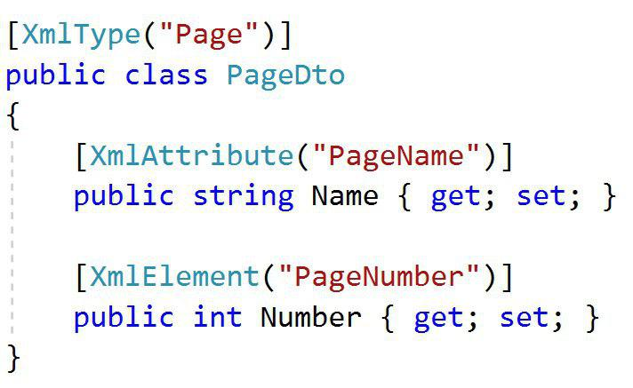
XML Attributes
Using xml attributes

Slide 23
XML Attributes
We can use several attributes to control serialization to XML
[XmlType("Name")] – Specifies the type’s name in XML
[XmlAttribute("name")] – Serialize as XML Attribute
[XmlElement] – Serialize as XML Element
[XmlIgnore] – Do not serialize
[XmlArray] – Serialize as an array of XML elements
[XmlRoot] – Specifies the root element name
[XmlText] – Serialize multiple xml elements on one line

Slide 24
XML Attributes: Example
We can use several XML attributes to control serialization
XML Type name
[XmlType("Book")]
public class BookDto
{
[XmlAttribute("name")]
public string Name { get; }
[XmlElement("Author")]
public string Author { get; }
[XmlIgnore]
public decimal Price { get; }
}
<Book name="It">
<Author>Stephen King</Author>
</Book>
<Book name="Frankenstein">
<Author>Mary Shelley</Author>
</Book>
<Book name="Queen Lucia">
<Author>E.F. Benson</Author>
</Book>
<Book name="Paper Towns">
<Author>John Green</Author>
</Book>
Not serialized

Slide 25


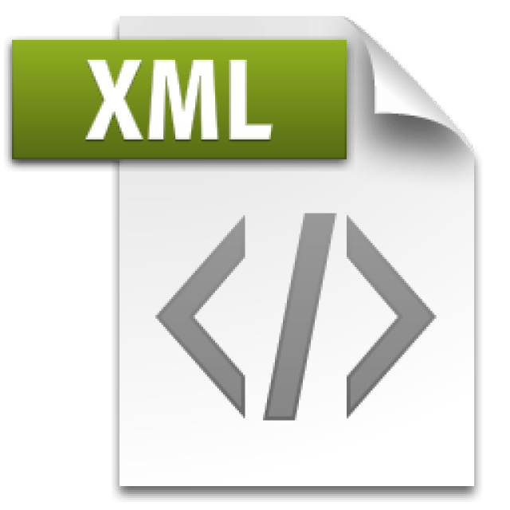
XML Serialization
Live Demo

Slide 26

Summary
XDocument is a system object for working with XML in .NET, which supports LINQ
XML can be read and saved directly to file
XML Attributes are easy way to describe the XML file

Slide 27







XML Processing
https://softuni.bg/courses/databases-basics-ms-sql-server

Slide 28






SoftUni Diamond Partners

Slide 29






SoftUni Diamond Partners

Slide 30
License
This course (slides, examples, demos, videos, homework, etc.) is licensed under the "Creative Commons Attribution-NonCommercial-ShareAlike 4.0 International" license
Attribution: this work may contain portions from
"Databases" course by Telerik Academy under CC-BY-NC-SA license

Slide 31





Trainings @ Software University (SoftUni)
Software University – High-Quality Education, Profession and Job for Software Developers
softuni.bg
Software University Foundation
http://softuni.foundation/
Software University @ Facebook
facebook.com/SoftwareUniversity
Software University Forums
forum.softuni.bg

